Slide 1
GOB
LED Digital Signage

Slide 2
What is GOB?
Glue on board is short for GOB.Filling a layer of glue on the surface of the modules to improve the protection of the entire screen.
It is a packaging technology.It is a technology to solve the problem of LED diodes protection. It uses an advanced new transparent material to encapsulate the substrate and its LED packaging unit to form effective protection.
The material not only has ultra-high transparency performance, but also possesses ultra- high thermal conductivity. The GOB LED display can be adapted to any harsh environment,realizing the characteristics of true moisture resistance, waterproof, dustproof, impact resistance, UV resistance and so on.

Slide 3
Features 1
A n t i - C O L L I S I O N , a v o i d t h e
d a m a g e c a u s e d t o L E Ds d u r i n g t r a n s p o r t a t i o n o r h a n d l i n g
A n t i - K N O C K , a v o i d d a m a ge t o t h e p r o d u c t c a u s e d b y c o l l i s i o n w i t h o t h e r p e o p l e o r o b j e c t s

Slide 4
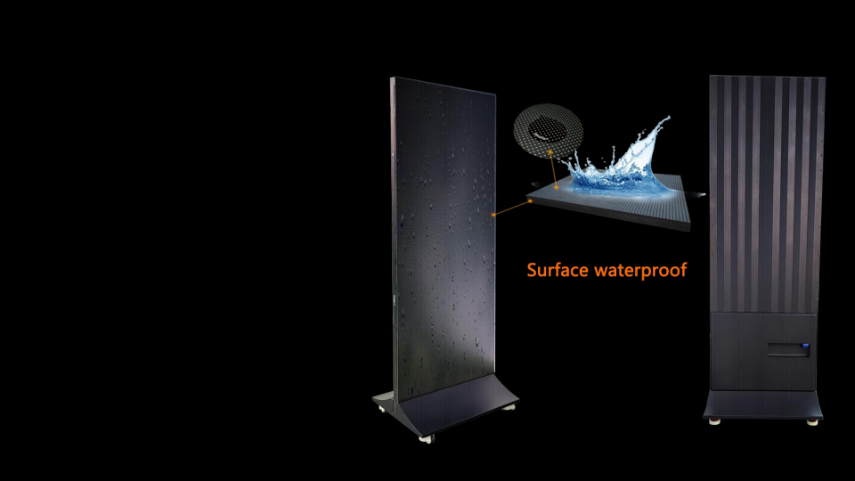
Features 2
F r o n t S u r f a c e i s w a t e r p r o o f , c a n r e s i s t s p l a s h i n g w a t e r , s u c h a s m o p p i n g t h e f l o o r , c h i l d r e n s p l a s h
M a t t e s u r f a c e t e c h n o l o g y , n o r e f l e c t i o n , n o s c r e e n , u n i f o r m h e a t d i s s i p a t i o n

Slide 5
Features 3
D u s t - p r o o f . L E Ds c a n ’ t m e e t t h e d u s t s i n c e t h a t i t h a s g l u e i n f r o n t .
S c r u b b i n g . A f t e r a c c u m u l a t i n g d u s t o r h a n d m a r k s o n t h e s u r f a c e , i t c a n b e s c r u b b e d

Slide 6
Features 4
3x1 4x1
2x1
5x1
1x1
S e a m l e s s s p l i c e . D i s p l a y c a n b e c o n n e c t e d t o g e t h e r f a s t l y w i t h v a r i e s q u a n t i t i e s . M a x i m u m c o n n e c t i o n i s 1 0x 1 u n i t s .

Slide 7
Features 5
1 6 : 9 d i s p l a y r a t i o . W i t h 5 u n i t s c o n n e c t i o n , c a n g e t 1 6 : 9 d i s p l a y r a t i o n , p e r f e c t m a t c h w i t h m o s t v i d e o s o u r c e s
S p l i t s c r e e n d i s p l a y . T h e d i s p l a y a r e a c a n b e s p l i t e d f o r d i s p l a y i n g d i f f e r e n t c o n t e n t s

Slide 8
Features 6
I n t e l l i g e n t c l u s t e r i n g m a n a g e m e n t
T h r o u g h I O S a n d A n d r o i d , P C d e v i c e s , i n t e l l i g e n t c l o u d c o n t r o l s y s t e m , t o a c h i e v e I n t e r n e t c l u s t e r m a n a g e m e n t .
C o n t e n t c a n b e p u s h e d t o g l o b a l s c r e e n s a n y t i m e , a n y w h e r e .
Grasp the hand of the times
Application:

Slide 9
Features 7
SpecificationsSpecificationsSpecifications
D I Y i n s t a l l a t i o n . S u p p o r t t r a n s v e r s e s p l i c i n g . E v e n s u p p o r t s p e c i a l s h a p e s p l i c i n g . s u c h a s M / W , f a n b l a d e , s a w t o o t h s h a p e e t c .

Slide 10
Features 8
M u l t i - f u c t i o n s . P l u g & p l a y , c o n t r o l l e d v i a W I F I , H D M I , 3 G , 4 G , a n d U S B , e v e n c o u l d b e c o n t r o l l e d t h r o u g h m o b i l e p h o n e

Slide 11
Specifications
Pixel pitch(mm) | 2.5 | 2 | 1.86
Module cabinet(mm) | 320 x 160
Display screen(mm) | 640 x 1760
Whole screen size | 640x1930x46mm(L*H*D)
Screen resolution(pixels) | 256 x 704 | 320 x 880 | 344 x 946
Brightness(nits) | 800
Refresh rate(Hz) | 1920/3840
Maximum power(w/set) | 800
Average power(w/set) | 200
Operating temperature | -30°C~60°C
Weight(kgs) | 36.5
Wireless configuration | Lan,WiFi， 4G， USB

Slide 12
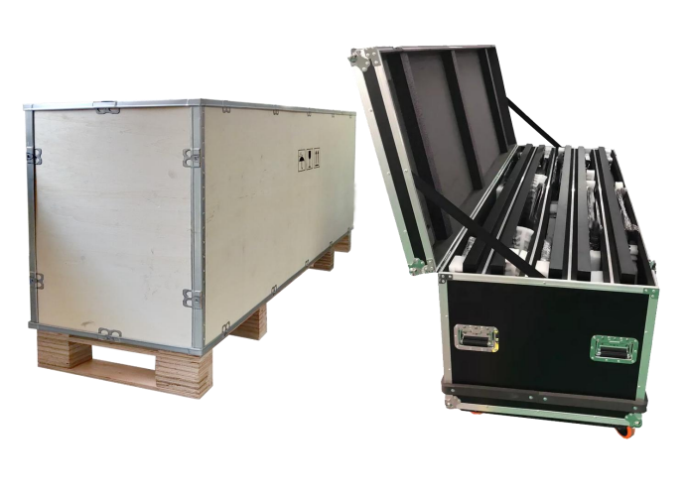
Packing
SpecificationsSpecificationsSpecifications
W o o d e n c as e a n d f l i g h t c as e o p t i o n

Slide 13
Packing List
Wooden case |  |  | Flight case
Quantities | Dimensions | Weight | Quantities | Dimensions | Weight
1 in 1 | 1.89*0.26*0.87m | 54kg | 1 in 1 | 1.94*0.35*0.87m | 85kg
2 in 1 | 1.89*0.34*0.87m | 96kg | 2 in 1 | 1.94*0.46*0.87m | 134kg
3 in 1 | 1.89*0.44*0.87m | 139kg | 3 in 1 | 1.94*0.57*0.87m | 184kg
4 in 1 | 1.89*0.54*0.87m | 182kg | 4 in 1 | 1.94*0.71*0.87m | 237kg
5 in 1 | 1.89*0.63*0.87m | 225kg | 5 in 1 | 1.94*0.85*0.87m | 291kg
Note:The actual packing weight shall prevail
SpecificationsSpecificationsSpecifications

Slide 14
Applications
T r a n s p o r t a t i o n s H U B a r e a
S u c h a s A i r p o r t , R a i l w a y S a t i o n , B u s S t a t i o n , S u b w a y , C u s t o m s I n s p e c t i o n e t c

Slide 15
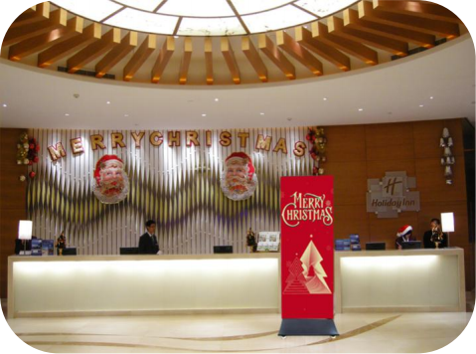
Applications
H o t e l , G y m , C o m p a n y
I t i s g o o d f o r p u t t i n g i n f r o n t o f t h e r e c e p t i o n d e s k , a s t h e g u e s t l e a ds

Slide 16
Applications
S h o p p i n g M a l l ,
I t i s g o o d f o r a d v e r t i s i n g i n s i d e t h e s h o p p i n g m a l l t o c a t c h t h e c u s t o m e r v i s i o n . S t i m u l a t e c u s t o m e r s ' d e s i r e t o b u y

Slide 17
Applications
R e s t a u r a n t , C a t e r i n g
A g r e a t d e v i c e t o a d v e r t is e y o u r d a i l y f l a g s h i p p r o d u c t s a n d y o u r p r o m o t i n g f o o d .

Slide 18
Applications
B r a n d C l o t h i n g S t o r e s , B r a n d S h o e s S t o r e s , B r a n d J e w l l e r y S t o r e s , B r a n d W a t c h
S t o r e s e t c
I t i s a g o o d m e d i a p l a y e r t o e n h a n c e t h e b r a n d i m a g e , a n d a t t h e s a m e
t i m e , i t c a n a t t r a c t c u s t o m e r s t o t h e s t o r e t o b u y a n d i n c r e a s e s a l e s .

Slide 19
Applications
E - s p o r t s w a t c h i n g s c r e e n
I t c a n b e u s e d a s a l a r g e s c r e e n o f e - s p o r t s t o w a t c h , w i t h r i c h e r c o l o r s a n d m o r e r e a l i s t i c d i s p l a y e f f e c t .

Slide 20
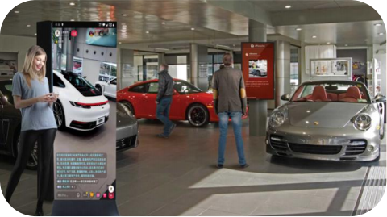
Applications
C a r S h o p
T h e i d e a l p o s t e r f o r a c a r d e a l e r s h i p . C a n a d v e r t is e t h e n e w c a r ' s f e a t u r e s , p o s i t i o n i n g a n d p r i c e . H e l p c u s t o m e r s u n d e r s t a n d t h e p r o d u c t q u i c k l y .

Slide 21
SpecificationsSpecificationsSpecifications
Thanks !
Lokingforwardtoworkingwithyou.

