Slide 1

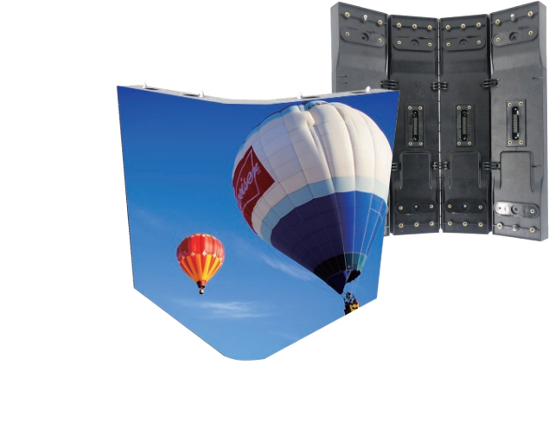




www.3rgbled.com
3D Design Outdoor
Outdoor Fixed SMD LED Display
40%
Energy-saving
Light Weight
0~360 degree
Higher Brightness

Slide 2
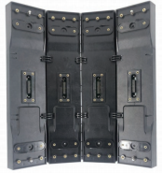
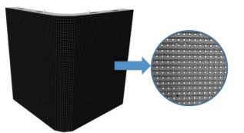
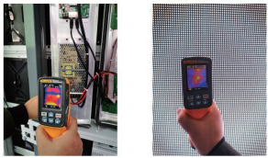
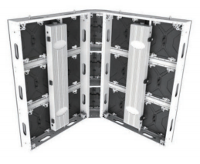
0~360 degree adjustment curved angle Higher Brightness
0~360 degree adjustment curved angle. Higher brightness of up to 10000 nits
Economic
Front or back maintenance
Front or back maintenance.
Energy Saving & Low Temperature.
Main Technical Specifications
Pixel Pitch(mm) | 6.6 | 8 | 10
Module Size(mm) | 320 x 320 | 320 x 320 | 320 x 320
Module Resolution | 48 x 48 | 40 x 40 | 32 x 32
Weight(Kg) | 28kg/m ² | 28kg/m ² | 28kg/m ²
Input Voltage | 100~240VAC | 100~240VAC | 100~240VAC
Cabinet size | 1280 x 960 | 1280 x 960 | 1280 x 960
Cabinet Resolution | 192 x 144 | 160 x 120 | 128 x 96
Brightness (Nits) | 6000-10000 | 6000-10000 | 6000-10000
Gray Scale (Bit) | 14 | 14 | 14
Best Viewing Distance | ≥6.6 m | ≥8 m | ≥10 m
Max./Avg Power Consumption(W/m2) | 184 / 590W | 184 / 590W | 184 / 590W
Refresh Rate | ≥1920 Hz | ≥1920 Hz | ≥1920 Hz
ITEM

