Slide 1
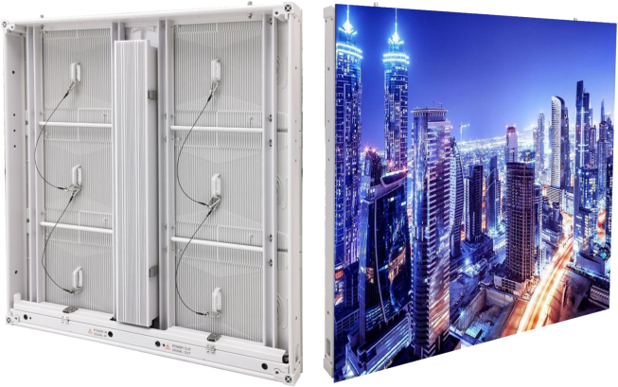
Platinum User Guide

Slide 2
GENERAL INFORM ATION
INTRODUCTION
Please read and understand the instructions in this manual carefully and thoroughly before attempting to operate this device. These instructions contain important safety and use information.
Platinum Series LED Video Panels offer the highest quality LED binning using 3-in-1 RGB SMD LEDs, with a brightness up to 10,000 NITS. Otherwise, all models have 6 individual modules for quick and easy front and rear accessible servicing; are built on the same frame, which allows panels with different resolutions to be used together. In addition, each Platinum Series LED Video Panel model has position pin located at the top to allow users to temporarily connect two panels correctly. Finally,there are additional handles helping user lift up the cabinet.
The Platinum Series LED Video Panel connections include PowerLock In/Out and DataLock In/Out, and feature built-in Novastar A5s receiving card. An optional wooden Case (purchased separately)
can carry up to 1x Platinum Series LED Video Panels or 6x Platinum Series LED Video Panels.
FABULUX offers full packages with video processors, software, cabling,and modules so that you have everything you need to get up and running.
UNPACKING
Every Platinum LED Video Panel has been thoroughly tested and has been shipped in perfect operating condition. Carefully check the shipping carton for damage that may have occurred during shipping. If the carton is damaged, carefully inspect the device for damage, and be sure all accessories necessary to install and operate the device have arrived intact. In the event damage has been found or parts are missing, please contact our customer support team for further instructions. Please do not discard the shipping carton in the trash. Please recycle whenever possible.
4 Fabulux Technology Co.,Ltd . SHENZHEN, CHINA

Slide 3
LIMITED WARRANTY
A. Fabulux Technology Co.,Ltd hereby warrants, to the original purchaser, Fabulux Technology Co.,Ltd products to be free of manufacturing defects in material and workmanship for a prescribed period from the date of purchase. This warranty shall be valid only if the product is purchased within China, including possessions and territories. It is the owner’s responsibility to establish the date and place of purchase by acceptable evidence, at the time service is sought.
B. For warranty service, Send the product only to the Fabulux Technology Co.,Ltd factory. All shipping charges must be prepaid. If the requested repairs or service (including parts replacement) are within the terms of this warranty, Fabulux Technology Co.,Ltd will pay return shipping charges. If the entire instrument is sent, it must be shipped in its original package and packaging material. No accessories should be shipped with the product. If any accessories are shipped with the product, Fabulux Technology Co.,Ltd shall incur no liability whatsoever for loss of or damage to any such accessories, nor for the safe return thereof.
C. This warranty is void if the product serial number and/or labels are altered or removed; if the product is modified in any manner which Fabulux Technology Co.,Ltd concludes, after inspection, affects the reliability of the product; if the product has been repaired or serviced by anyone other than the Fabulux Technology Co.,Ltd factory unless prior written authorization was issued to purchaser by Fabulux Technology Co.,Ltd; if the product is damaged because it was not properly maintained as set forth in the product instructions, guidelines and/or user manual.
D. This is not a service contract, and this warranty does not include maintenance, cleaning, or periodic checkup. During the period specified above, Fabulux Technology Co.,Ltd will replace defective parts at its expense with new or refurbished parts, and will absorb all expenses for warranty service and repair labor by reason of defects in material or workmanship. The sole responsibility of Fabulux Technology Co.,Ltd under this warranty shall be limited to the repair of the product, or replacement thereof, including parts, at the sole discretion of Fabulux Technology Co.,Ltd. All products covered by this warranty were manufactured after October15, 2020, and bear identifying marks to that effect.
E. Fabulux Technology Co.,Ltd reserves the right to make changes in design and/or improvements upon its products without any obligation to include these changes in any products theretofore manufactured.
F. No warranty, whether expressed or implied, is given or made with respect to any accessory supplied with products described above. Except to the extent prohibited by applicable law, all implied warranties made by Fabulux Technology Co.,Ltd in connection with this product, including warranties of merchantability or fitness, are limited in duration to the warranty period set forth above. And all warranties, whether expressed or implied, including warranties of merchantability or fitness, are limited in duration to the warranty period set forth above. The consumer’s and/or dealer’s sole remedy shall be such repair or replacement as is expressly provided above; and under no circumstances shall Fabulux Technology Co.,Ltd be liable for any loss and/or damage, direct and/or consequential arising out of the use of, and/or inability to use this product.
G. This warranty is the only written warranty applicable to Fabulux Technology Co.,Ltd products, and supersedes all prior warranties and written descriptions of warranty terms and conditions heretofore published.
MANUFACTURER’S LIMITED WARRANTY PERIODS:
LED Screen Products = 2-Year (For standard components, like cooper wired LEDs, normal ICdrivers, power supply, etc.)
LED Screen Products = 3-Year (For high quality components, like Golden wired SMD LEDs, normal IC drivers, power
supply, etc.)
LED Screen Products = 5-Year (please refer the sales contract for this specil configuration.)
CUSTOMER SUPPORT INFORMATION
Contact FABULUX Service for any product related service and support
needs. Also visit fabuluxled.com with questions, comments or suggestions. FABULUX SERVICE CHINA - Monday - Friday 8:30am to
18:00pm TEL 0755-61806688|
Fabulux Technology Co.,Ltd • SHENZHEN, CHINA 5

Slide 4
SAFETY GUIDELINES
This Platinum LED Video Panel is a sophisticated piece of electronic equipment. To guarantee a smooth operation, it is important to follow all instructions and guidelines in this manual. FABULUX is not responsible for injury and/or damages resulting from the misuse of this panel due to the disregard of the information printed in this manual. Only qualified and/or certified personnel should perform the installation of this panel and all included and/or rigging accessories. Any modifications to the panel, included and/or accessories will void the original manufactures warranty and increase the risk of damage and/or personal injury.
PROTECTION CLASS 1 - PANEL MUST BE PROPERLY GROUNDED.
THERE ARE NO USER SERVICEABLE PARTS INSIDE THIS PANEL.
DO NOT ATTEMPT ANY REPAIRS YOURSELF; DOING SO WILL VOID YOUR MANUFACTURES WARRANTY. DAMAGES RESULTING FROM MODIFICATIONS TO THIS PANEL AND/OR THE DISREGARD OF SAFETY INSTRUCTIONS AND GUIDELINES IN THIS MANUAL VOID THE MANUFACTURES WARRANTY AND ARE NOT SUBJECT TO ANY WARRANTY CLAIMS AND/OR REPAIRS. DO NOT PLUG PANEL INTO A DIMMER PACK! NEVER OPEN THIS PANEL WHILE IN USE! UNPLUG POWER BEFORE SERVICING PANEL! NEVER TOUCH FRONT OF PANEL DURING OPERATION, AS IT MAY BE HOT! KEEP FLAMMABLE MATERIALS AWAY FROM PANEL.
DO NOT SOAK THE PANEL IN THE WATER!
DO NOT SPILL WATER AND/OR LIQUIDS ON OR INTO THE PANEL!
DO NOT touch panel housing during operation. Turn OFF power and allow approximately 15 minutes for panel to cool down before servicing.
DO NOT: Operate a panel if any cover is open and/or removed.
DO NOT shake panel, avoid brute force when installing and/or operating panel.
DO NOT: Expose any part of the panel to open flame or smoke. Keep panel away from heat sources such as radiators, heat registers, stoves, or other appliances (including amplifiers) that produce heat.
DO NOT: Install/use panel in extreme hot/humid environments, or handle without ESD precautions. DO NOT: modify this product in any way that not described in the instruction manual.
DO NOT operate panel if power cord is frayed, crimped, damaged and/or if any of the power cord connectors are damaged and do not insert into the panel securely with ease. NEVER force a power cord connector into the panel.
DO NOT try to repair cables If the power cord or any of its connectors are damaged, replace it immediately with a new one of similar power rating.
ALWAYS disconnect panel from main power source before performing any type of service and/or cleaning procedure. Only handle the power cord by the plug end, never pull out the plug by tugging the wire portion of the cord.
6 Fabulux Technology Co.,Ltd . SHENZHEN, CHINA

Slide 5
SAFETY GUIDELINES
ONLY use the original packaging materials and/or case to transport the panel in for service. PLEASE recycle shipping boxes and packaging whenever possible.
CAUTION: To avoid physical damage, read the installation instructions carefully before installation. CAUTION: Panels should only be installed/operated by qualified and trained professionals ONLY. CAUTION: Always mount panels in a safe and stable manner.
CAUTION: The product can be normally used in the external temperature range of the maximum 40 and the minimum - 20 C.
CAUTION: Wear appropriate safety equipment during panel installation.
CAUTION: Turn OFF power to panel, computers, servers, system boxes, and monitors before making any type of power or data connections and performing any maintenance work.
CAUTION: Read user manual carefully to ensure normal operation and lifespan of the panel.
CAUTION: Electronics used in this panel are ESD (Electrostatic Discharge) sensitive. To protect device from ESD, wear a grounded ESD wrist strap or similar grounding device when handling panel.
CAUTION: Panel must be properly grounded before operating. (resistance must be less than 4Ω)
CAUTION: Ensure all power is disconnected from panel before unplugging any data cables from the panel, especially serial line ports.
CAUTION: Route power and data cables so that they are NOT likely to be walked on or pinched.
CAUTION: It should be installed from top to bottom and disassembled from bottom to top when hoisting. CAUTION: Test panel for 2-hours per week, if not used regularly or for an extended period.
CAUTION: Cases used to transport panel must me properly waterproofed for transportation.
Fabulux Technology Co.,Ltd • SHENZHEN, CHINA 7

Slide 6
MAINTENANCE GUIDELINES
Careful and regular maintenance is necessary to optimize the potential functional lifespan of the Platinum LED Video Panels.
1. Read the installation and operation instructions for correct operation of the Platinum LED Video Panels.
2. Although the Platinum LED Video Panels are designed and built to withstand some impact forces when installed correctly, take care to avoid impact damage when handling or transporting them,
especially corners and edges, which are particularly frangible during transportation. 3. Check each Platinum LED Video Panel for loose screws and other fasteners.
4. If the Platinum LED Video Panel installation is fixed or displayed for a lengthy time, regularly inspect all connecting plates and installation equipment, and replace or repair it as necessary, and during long periods of non-use, disconnect the main power to the unit.
5. Use necessary ESD (electrostatic discharge) precautions when handling PT LED Video Panels, especially the LED screens, as they are ESD sensitive and easily damaged from ESD exposure.
6. The Null Line and Live Line connections from the computer and control system cannot be reversed and should therefore only be connected in original layout order.
7. If the GFI (Ground Fault Interrupt) breaker-switch trips often, check the display or replace the power-supply switch.
8. When operating the Platinum LED Video Panels, power the computer before powering the LED Video Screens; conversely, when shutting down after operation, turn the LED Video Panels off before turning off the computer. If the PC is turned off first, a high intensity brightness might appear, causing catastrophic failure to those LEDs.
9. If while conducting an electrical test a circuit shorts, a breaker-switch trips, wires burn, and or any other abnormality appears, discontinue testing and troubleshoot units to find the problem before continuing with any testing or operation.
10. To ensure consistent operation, it might be necessary to learn operating parameters for installation, data recovery, backup, controller settings, and basic data preset modification.
11. Regularly check computer for any viruses and remove any irrelevant data.
12. Only a qualified technician should operate software system.
13. Remove any moisture found inside or outside of any Platinum LED Video Panels before dismantling video installation and returning them to their optional flight cases (sold separately). Ensure flight cases are free of any moisture, using a fan to dry them if necessary, and avoid ESD generating friction when returning Platinum LED Video Panels.
14. The Platinum LED Video Panels are within its IP66 rating parameters (front/ rear), limit or remove any unit exposed to moisture, condensation, or humidity, and consider using air conditioning where available.
15. When not in use, store Platinum LED Video Panels in a dry, well ventilated facility.
8 Fabulux Technology Co.,Ltd . SHENZHEN, CHINA

Slide 7
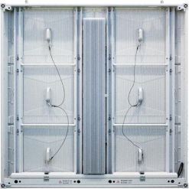
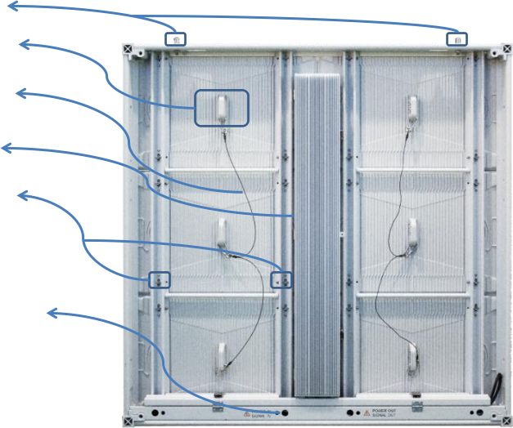
PANEL OVERVIEW
Dimension: 960x960x89.2mm
1
960mm
960mm
Position Pin
Module Handle
Safety Rope
Power Box
Structure Lock
Cable Hidden Groove
Fabulux Technology Co.,Ltd • SHENZHEN, CHINA 9

Slide 8
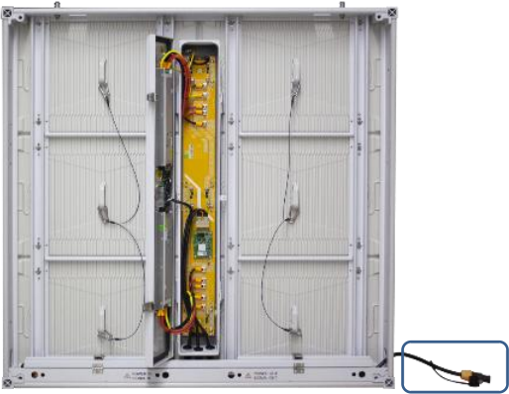
PANEL OVERVIEW
Power Supply
HUB Card
Receiving Card
Input Power Cable & Input Signal
Cable
10 Fabulux Technology Co.,Ltd . SHENZHEN, CHINA

Slide 9
THE LIST OF THE TOOL
 | Name | Specs | Picture
Front Installation | Connecting Plate between cabinets | 143x77mm
 | Screw for the cabinet left and right fixed | M10*52
 | Screw for the cabinet front and back fixed | M8*95
 | T-type Allen wrench, for Platinum module 480x320mm, pixel pitch 6.67mm, 8mm and 10mm | M2.5
 | T-type Allen wrench, for Platinum module 480x320mm, pixel pitch 5.7mm | M2
Side Installation | Connecting Plate for both side cabinets installation
 | Screw for the cabinet left and right fixed | M10*52
 | Screw for the cabinet front and back fixed | M10*75
 | Hex wrench for connection plate screws, front installation. | M6
Fabulux Technology Co.,Ltd • SHENZHEN, CHINA 11

Slide 10
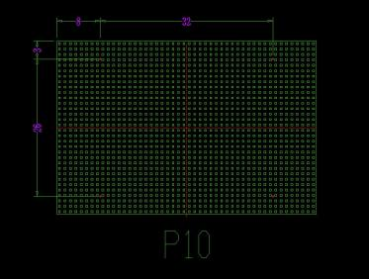
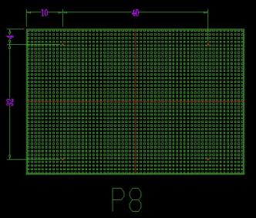
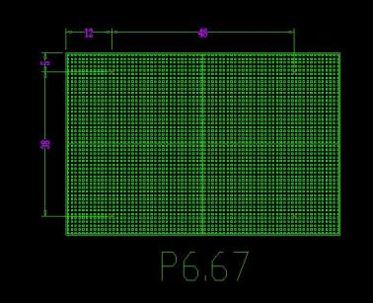
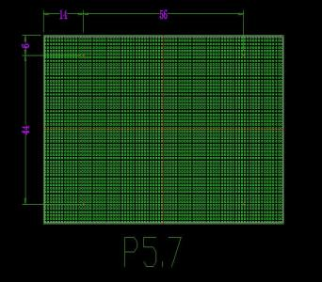
MAINTENANCE STEPS
1. Front Maintenance
A. Module Maintenance
① There is 4 lock holes on each module, located at 4 directions; and different pixel pitch is of different locations; please refer above pictures.
12 Fabulux Technology Co.,Ltd . SHENZHEN, CHINA

Slide 11
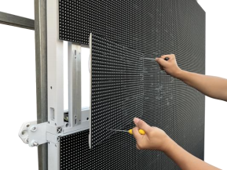
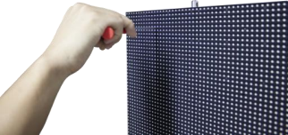
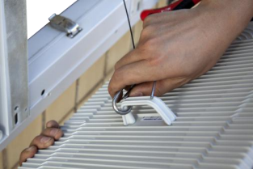
② Insert T-type Allen
wrench M2.5 into each
lock hole, rotate 90 degree to the left, to open the lock.
③ Insert two T-shaped Allen wrenches into the diagonal lock holes, and pull outward at the same time, to remove the module.
④ There is a safety rope to catch each module, unhook the safety rope. Please do the same way to take
other modules out.
Fabulux Technology Co.,Ltd • SHENZHEN, CHINA 13

Slide 12
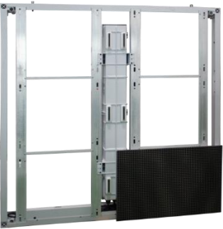
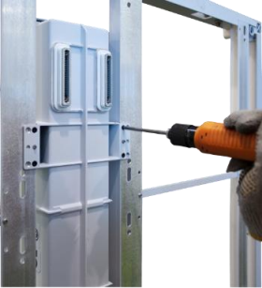
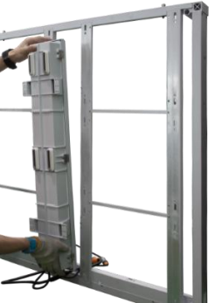
B. Power box maintenance
① Remove 6 modules from the front of cabinet;
there will be the power box at the middle.
② There is two plates with screws at the power box, one for the top, each side with 2 screws; another one on the bottom, Total 8 screws;
③ Then please catch the power box up and down, and remove the power box.
14 Fabulux Technology Co.,Ltd . SHENZHEN, CHINA

Slide 13
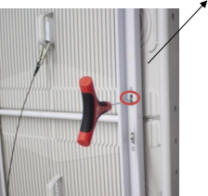
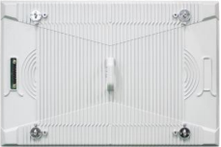
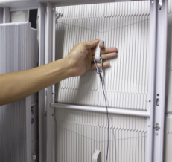
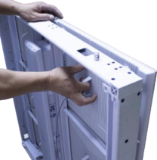
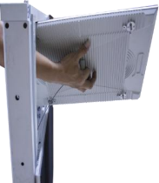
2.Rear Maintenance
A.Module Maintenance
1) Locate the four mechanism locks
2) Release the 4 locks of each module by M2.5
3) Unlock the safety rope
4) Catch the handle of the module
5) Push the module forward
6) Take the module out diagonally
Fabulux Technology Co.,Ltd • SHENZHEN, CHINA 15

Slide 14
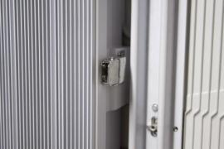
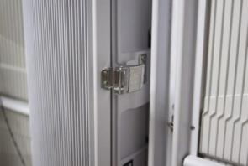
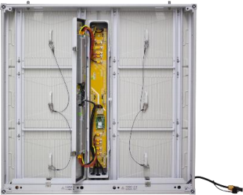
B. Power box maintenance
1) There is two buckles on the power box, one is located at the top, another one is located at the bottom.
2) Open these two buckles.
3) Then you can do the maintenance for the power supply, receiving cards, HUB cards, etc.
16 Fabulux Technology Co.,Ltd . SHENZHEN, CHINA

Slide 15
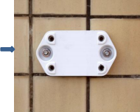
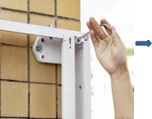
Installation type 1: Wall-mounted directly
Application: Fabulux designs the platinum cabinet for wall-mounted directly; it is good for outdoor small signs installation.
. Before Installation
1.check the stress condition of the wall surface, and the wall should be concrete structure. 2.check the smoothness of the wall surface, the wall surface should be the same level.
. Steps of installation
1) Install connecting plate
1)Drill the hole 2)Locate plate with screw 3)Fixed the screw 4)Complete the screws
5)Fix the cabinet on top 6)Fix the cabinet on bottom 7) Tighten the screws 8) Finish installation
Fabulux Technology Co.,Ltd • SHENZHEN, CHINA 17

Slide 16
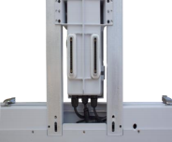
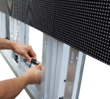
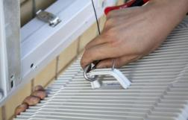
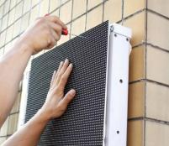
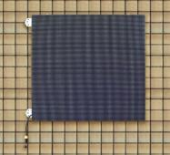
9) Connect the signal & power cable from front
10) Cover the cable
10) Put the module onto cabinet
12) Lock the module
13) Finish install the modules
. After installation
1. Check that each corner is secure, tap the module to ensure the smoothness of the screen, to avoid bad installation caused by not bright.
2.Debugging software
18 Fabulux Technology Co.,Ltd . SHENZHEN, CHINA

Slide 17
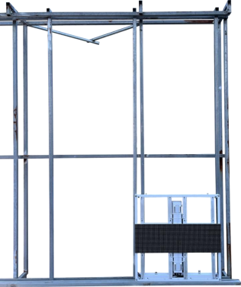
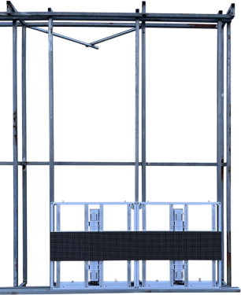
Installation type 2: Totally front installation
Application: there is no space for rear installation and service; attach the steel structure into the wall first; then install all cabinets, cables, etc from front.
Preparation of install:
1. Install the steel structure, make sure the welding is correct according to the drawing, and spray paint. 2. Check the steel structure, make sure it is horizontal and vertical
1) Take off the corner modules and put cabinet on the first floor; put cabinets together.
Fabulux Technology Co.,Ltd • SHENZHEN, CHINA 19

Slide 18
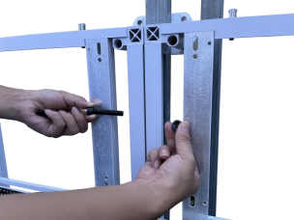
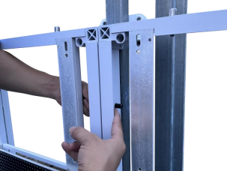
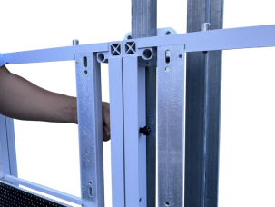
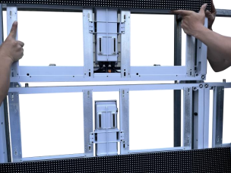
2) Put the connecting plate and M8*95 screw first
3) Fix the screw with Hex Wrench M8
4) Connect two cabinets together with screws from side
5) Put through the screws
6) Fix the nuts, tighten cabinets together
7) Put cabinet on top, located the position with two pins.
20 Fabulux Technology Co.,Ltd . SHENZHEN, CHINA

Slide 19
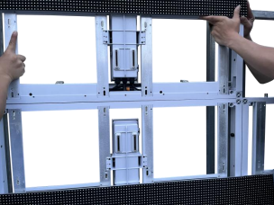
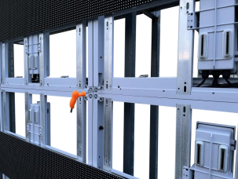
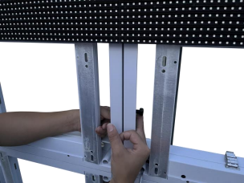
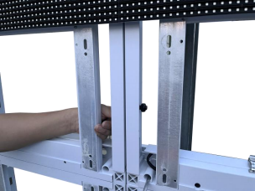
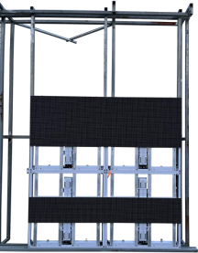
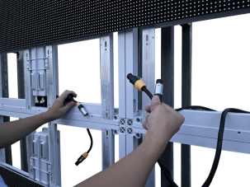
8) Then put the cabinet down.
9) Lock the screw to the connection plate with hex wrench M8.
10) Lock two cabinets together with screw
11) Tighten screw with nut
12) Finish installation of 4 cabinets.
13) Take cables out from the bottom of cabinet
Fabulux Technology Co.,Ltd • SHENZHEN, CHINA 21

Slide 20
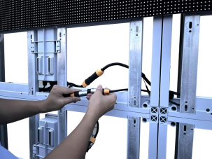
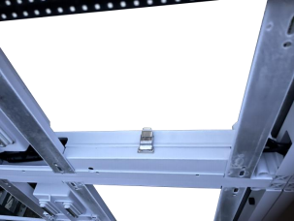
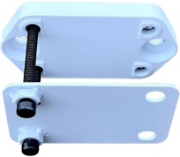
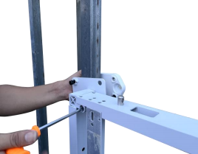
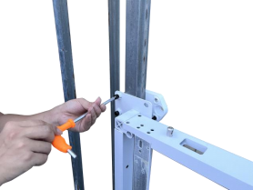
14) Go through the cables from the cabinet
15) Connect cables together
16) lock the cable cover.
17) Connect the plates and screws for side of the screen.
18) Fix the connecting plates from the left side.
19) Fix the screws for the side plates.
22 Fabulux Technology Co.,Ltd . SHENZHEN, CHINA

Slide 21
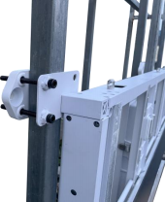
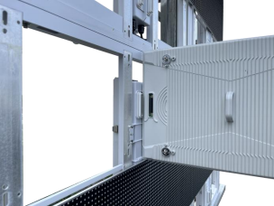
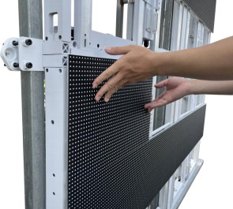
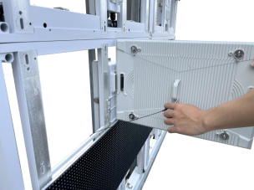
20) Lock it together tightly.
21) Put the module back
22) Put the safety rope.
23) Install modules onto the cabinet.
24) Lock the module with T-type Allen Wrench.
Fabulux Technology Co.,Ltd • SHENZHEN, CHINA 23

Slide 22
Installation type 3: Totally Rear installation
Application: there is space for rear installation and service
1) Prepare the structure and put the first cabinet.
2) Put two cabinet together first.
3) Lock the connecting plate to the cabinet with M10*75 screw from back.
4) Lock two cabinets onto the steel square pipe.
5) Connect left and right cabinets with screw and nut.
6) Put the screw through the cabinets.
24 Fabulux Technology Co.,Ltd . SHENZHEN, CHINA

Slide 23
7) Tighten the screw with nut.
8) Fix two cabinets together with top and down screws.
9) Put cabinet on top of the first row.
10) Locate the top cabinet with position pins.
11) Put screws through the connection plate to the cabinet.
12) Fix the screw with Hex wrench.
Fabulux Technology Co.,Ltd • SHENZHEN, CHINA 25

Slide 24
13) Fix all screws to the connecting plate
14) One connecting plate for 4 cabinets.
15) Put the cables through the cabinets
16) Connect cables together.
17) Put cables back to the cover.
18) Lock the cover and finish installation.
26 Fabulux Technology Co.,Ltd . SHENZHEN, CHINA

Slide 25
19) Connecting plate for side screen.
20) Put the connecting plates
21) Lock the connecting plate with screws
22) Finish the installation .
Fabulux Technology Co.,Ltd • SHENZHEN, CHINA 27

Slide 26
Package and transportation
A.Package
B.Transportation
Some reference data for loading(Suppose the space is fully utilised)
Name | Size | Weight (after packing) | Total Panels (960*960mm/pcs) | Total Wooden Cases(Qty)
Wooden case | 1.04*0.76* 1.13m | 190 KG | 6pcs | 1
Container | 20’GP | / | 168pcs | 28
Container | 40’ HQ | / | 360pcs | 60
28 Fabulux Technology Co.,Ltd . SHENZHEN, CHINA

Slide 27
Technical Specifications
Item Number | FAB-PT5.7 | FAB-PT6.67 | FAB-PT8 | FAB-PT10
Pixel Pitch(mm) | 6 | 7 | 8 | 10
Pixel Density(dots/SQM) | 30,625 | 22,500 | 15,625 | 10,000
LED type | SMD2727 | SMD2727 | SMD3535 | SMD3535
Module Resolution(pixels) | 84*56 | 72*48 | 60*40 | 48*32
Module Size(mm) | 480*320 | 480*320 | 480*320 | 480*320
Cabinet Size(mm) | 960*960 | 960*960 | 960*960 | 960*960
Cabinet Weight(KG) | 28 | 28 | 28 | 28
Brightness(Nits) | 6000-9000 | 6000-9000 | 6000-10000 | 6000-10000
Refreshment(Hz) | 3,840 | 3,840 | 3,840 | 3,840
Grey Scale(Bit) | ≥14 | ≥14 | ≥14 | ≥14
Max Power Consumption(W/SQM) | 580 | 580 | 550 | 550
Ave Power Consumption(W/SQM) | 150 | 150 | 150 | 150
Maintenance type | Front/Rear | Front/Rear | Front/Rear | Front/Rear
Protecting level | IP66/IP66 | IP66/IP66 | IP66/IP66 | IP66/IP66
Certificate | CE,FCC,ETL,EMC,CB,ROHS

Slide 28
Optional components & Accessories
Part name | Description | Picture
Nova controller TB6 | Loading capacity: 130W Maximum resolution:width4096 hight1092 Video decoder: 4K U disk expansion: 128G Control mode: Wired、WiFiAp WiFi Sta 、4G
Nova stroller MSD300 | Loading capacity: 130W Maximum resolution:width3840 hight3840 Video decoder: 1920 1200 Functional connector:Light Sensor
Nova stroller MCTRL660 | Loading capacity: 230W Maximum resolution:width3840 hight3840 Video decoder: 1920*1200 Video source depth: 8/10/12bit
Nova stroller VX600 | Loading capacity: 390W Maximum resolution:width10240 hight8192 Picture Layers:3*1K*2K
Waterproof controller box | To protect the controller/sending Box from water and rain
Power distributor box | Designed based on the display electricity consumption and environmental conditions
Fiber cable | Realize long-distance signal transmission
Fiber converter | Complete the conversion of serial port to optical fiber,extend the transmission distance of serial communication signals
30 Fabulux Technology Co.,Ltd • SHENZHEN, CHINA

